Slide 1
TimeSlice F1 API
Sam Hurst
Notes:
Intro about what project is an how f1, lot of data out there but being able to take it and interpreter in own way is limited.

Slide 2
Software Stack
Programming Language : Python (3.13)
Libraries and Frameworks: Fats APi, SQLAlchemy, Pedantic
Database: Azure (POSTSQL)
Hosting: Render
External Resources: Open F1 API

Slide 3
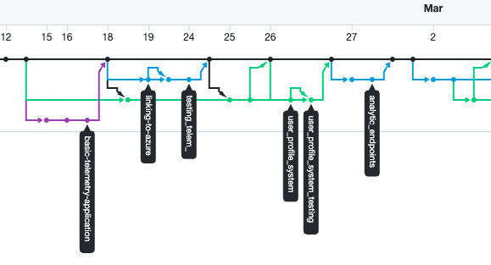
Version Control
Primary Tool: Github
Commit & Branching Practices
Allows Automated Hosting: Render
Notes:
Why github :central point of control Commonly used and lot of experience
Git Practices : Operate off committing once feature is complete and more general system of group into key task as creating initial lap summary endpoints
Render: allows runs off a selected branch

Slide 4
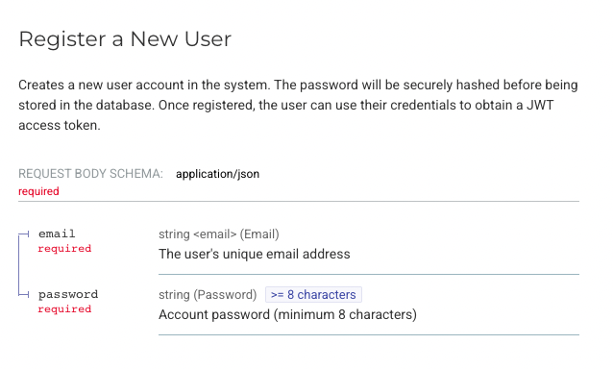
API Documentation
Swagger UI
Dual Documentation: Redoc, Doc
Examples and Requirements
Standardised Result

Slide 5



GenAI
Used Throughout the Process
Used a range of Task specific
Purleixty: Technical Report
Gemini: Coding
University CoPilot: Initial Ideation
Gamma: Presiontion Ideation

Slide 6
Demo
Notes:
DEMO in GIT REPO https://github.com/SamHurst47/Web_Ser_API/tree/main

